Slide 1

ME322: Machine Design
Hydrodynamic bearings
Prof. S. K. Kakoty

Slide 2
Reynolds Equation
The generalized Reynolds equation as derived by Osborne Reynolds in 1885 is given as
…….…..… (1)
where is the fluid pressure, is the film thickness, is the fluid density, is the viscosity of the fluid and U is the sliding speed in x- direction. x and z are the coordinates in the direction of sliding and the length of the bearing.

Slide 3
The Reynolds equation for incompressible fluid ( = constant) is given as
………………. (2)
The Reynolds equation was first solved by Sommerfeld (1905) for infinitely long journal bearing.
Later Ockvirk (1953) solved the equation for infinitely short journal bearing.
Though there are approximate analytical solutions of this two-dimensional partial differential equation, the solutions are too clumsy.
For bearings with finite length there is no exact analytical solution of Reynolds equation. However, the numerical solution provided by Raimondi and Boyd is considered to be close to experimental results.

Slide 4
Note: Refer to books like “ Introduction to Tribology of Bearings” by B C Majumdar for detail derivation of Reynolds equation

Slide 5
Raimondi and Boyd method
There is no exact solution to Reynolds equation for a journal bearing or a slider bearing having a finite length.
However, AA Raimondi and John Boyd of Westinghouse Research Laboratory solved this equation on computer using the iteration technique.
The results of this work are available in the form of charts and tables. In the Raimondi and Boyd method, the performance of the bearing is expressed in terms of dimensionless parameters.
The values of these parameters for a full journal bearing (360º arc) with side flow are given in Table 1.

Slide 6
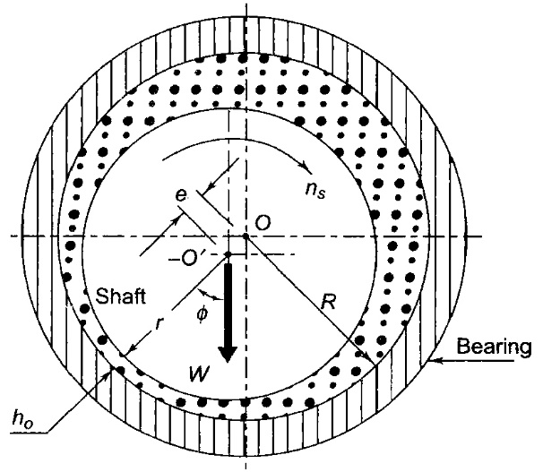
Dimensionless parameters
Eccentricity Ratio
The radial clearance ‘c’ is given by …………… (3)
where c=radial clearance (mm), R=radius of bearing (mm) and r=radius of journal (mm)
Fig 1: Journal bearing

Slide 7
The eccentricity ratio is defined as the ratio of eccentricity to radial clearance. Therefore,
……………... (4)
2. Minimum film thickness
From Fig.1,
……………. (a)
where, = minimum film thickness (mm)
Using eq. 3, eq. 4 and eq. (a), we get
or ..…………… (5)
The quantity is called the minimum film thickness variable.

Slide 8
3. Sommerfeld Number
Sommerfeld number is given as
…………………. (6)
where, S = Sommerfeld number
= viscosity of the lubricant (N-s/mm²) or (Mpa-s)
= journal speed (rev./s)
P = unit bearing pressure, i.e., load per unit of the projected area (N/mm²) or (MPa)
Note: The Sommerfeld number contains all the variables that are controlled by the designer

Slide 9
4. Attitude Angle
The angle shown in Fig. 1 is called the angle of eccentricity or eccentricity ratio. It locates the position of minimum film thickness with respect to the direction of load. The values of given in Table 1 are in degrees.
Table 1: Dimensionless performance parameters for full journal bearing with side flow
∞ | 0 | 1.0 | ∞ | (70.92) | ∞ |  | 0 | -
 | 0.1 | 0.9 | 0.240 | 69.10 | 4.80 | 3.03 | 0 | 0.826
 | 0.2 | 0.8 | 0.123 | 67.26 | 2.57 | 2.83 | 0 | 0.814
 | 0.4 | 0.6 | 0.0626 | 61.94 | 1.52 | 2.26 | 0 | 0.764
 | 0.6 | 0.4 | 0.0389 | 54.31 | 1.20 | 1.56 | 0 | 0.667
 | 0.8 | 0.2 | 0.021 | 42.22 | 0.961 | 0.760 | 0 | 0.495

Slide 10
Table 1: Continued…
∞ | 0.9 | 0.1 | 0.0115 | 31.62 | 0.756 | 0.411 | 0 | 0.358
 | 0.97 | 0.03 | - | - | - | - | 0 | -
 | 1.0 | 0 | 0 | 0 | 0 | 0 | 0 | 0
1 | 0 | 1.0 | ∞ | (85) | ∞ |  | 0 | -
 | 0.1 | 0.9 | 1.33 | 79.5 | 26.4 | 3.37 | 0.150 | 0.540
 | 0.2 | 0.8 | 0.631 | 74.02 | 12.8 | 3.59 | 0.280 | 0.529
 | 0.4 | 0.6 | 0.264 | 63.10 | 5.79 | 3.99 | 0.497 | 0.484
 | 0.6 | 0.4 | 0.121 | 50.58 | 3.22 | 4.33 | 0.680 | 0.415
 | 0.8 | 0.2 | 0.0446 | 36.24 | 1.70 | 4.62 | 0.842 | 0.313
 | 0.9 | 0.1 | 0.0188 | 26.45 | 1.05 | 4.74 | 0.919 | 0.247
 | 0.97 | 0.03 | 0.00474 | 15.47 | 0.514 | 4.82 | 0.973 | 0.152
 | 1.0 | 0 | 0 | 0 | 0 | 0 | 1.0 | 0

Slide 11
Table 1: Continued…
 | 0 | 1.0 | ∞ | (88.5) | ∞ |  | 0 | -
 | 0.1 | 0.9 | 4.31 | 81.62 | 85.6 | 3.43 | 0.173 | 0.523
 | 0.2 | 0.8 | 2.03 | 74.94 | 40.9 | 3.72 | 0.318 | 0.506
 | 0.4 | 0.6 | 0.779 | 61.45 | 17.0 | 4.29 | 0.552 | 0.441
 | 0.6 | 0.4 | 0.319 | 48.14 | 8.10 | 4.85 | 0.730 | 0.365
 | 0.8 | 0.2 | 0.0923 | 33.31 | 3.26 | 5.41 | 0.874 | 0.267
 | 0.9 | 0.1 | 0.0313 | 23.66 | 1.60 | 5.69 | 0.939 | 0:206
 | 0.97 | 0.03 | 0.00609 | 13.75 | 0.610 | 5.88 | 0.980 | 0.126
 | 1.0 | 0 | 0 | 0 | 0 | - | 1.0 | 0
 | 0 | 1.0 | ∞ | (89.5) | ∞ |  | 0 | -
 | 0.1 | 0.9 | 16.2 | 82.31 | 322.0 | 3.45 | 0.180 | 0.515
 | 0.2 | 0.8 | 7.57 | 75.18 | 153.0 | 3.76 | 0.330 | 0.489
 | 0.4 | 0.6 | 2.83 | 60.86 | 61.1 | 4.37 | 0.567 | 0.415

Slide 12
Table 1: Continued…
 | 0.6 | 0.4 | 1.07 | 46.72 | 26.7 | 4.99 | 0.746 | 0.334
 | 0.8 | 0.2 | 0.261 | 31.04 | 8.8 | 5.60 | 0.884 | 0.240
 | 0.9 | 0.1 | 0.0736 | 21.85 | 3.50 | 5.91 | 0.945 | 0.180
 | 0.97 | 0.03 | 0.0101 | 12.22 | 0.922 | 6.12 | 0.984 | 0.108
 | 1.0 | 0 | 0 | 0 | 0 | - | 1.0 | 0

Slide 13
5. Coefficient of friction variable
The coefficient of friction variable (CVC) is given by
………………… (7)
where f is the coefficient of friction.
6. Coefficient of flow variable
The flow variable (FV) is given by
………………… (8)
where,
l=length of the bearing (mm)
Q=flow of the lubricant (mm³/s)

Slide 14
Q represents the total flow of the lubricating oil, a part of which is circulated around the journal, while the remaining oil flows as side leakage ( ).
represents the side leakage, which can be calculated from the values of parameter given in the table 1.
The maximum pressure ( ) developed in the film is calculated from the ratio given in last column of the table 1.
The values are based on the assumption that the oil is supplied at the atmospheric pressure. If the oil is supplied at the higher pressure, the maximum pressure ( ) will also increase by the corresponding value.

Slide 15
Frictional Torque
The frictional torque is given by,
……………… (9)
Temperature Rise
Viscous friction results in heat generation.
Rise in temperature of the lubricant takes place due to heat generation

Slide 16
Assuming that the total heat generated in the bearing is carried away by the total oil flow in the bearing, the expression for temperature rise can be determined.
The heat generated ( ) is given by,
Substituting,
The heat carried away by oil flow is ( ) is given by
Where, m=mass of the lubricating oil passing through the bearing (kg/s)

Slide 17
= specific heat of lubricating oil (kJ/kg°C)
= temperature rise (°C)
The mass of the lubricating oil is given by
Substituting
The mass is given by
……………. (c)
Substituting Eq. (c) in Eq. (b),
Equating the expressions for and ,
……………. (10)

Slide 18
For most lubricating oils,
and
Substituting these values in Eq. (10)
………………. (11)
The average temperature of the lubricant is given by
………………. (12)
where is the inlet pressure

Slide 19
Bearing Design-Selection of parameters
Very often, in the preliminary stages of journal bearing design, it is required to select suitable values for the following parameters:
Length to Diameter ratio
Unit bearing pressure
Start-up load
Radial clearance
Minimum oil film thickness
Maximum oil film temperature

Slide 20
Length to Diameter Ratio
Shaft diameter is generally known/ given/ determined considering bending, torsion and other considerations.
The designer has to decide on the length of the bearing to obtain a given bearing capacity.
The performance of the bearing depends on the length to diameter ratio.
A long bearing has more load carrying capacity compared with a short bearing.
A short bearing, on the other hand, has greater side flow, which improves heat dissipation.
The long bearings are more susceptible to metal to metal contact at the two edges, when the shaft is deflected under load. The longer the bearing, the more difficult it is to get sufficient oil flow through the passage between the journal and the bearing.

Slide 21
The design trend is to use (l/d) ratio as 1 or less than 1 when side flow is the criterion for cooling the bearing.
When the shaft and the bearing are precisely aligned, the shaft deflection is within the limit and cooling of lubricant and bearing does not pose a serious problem, the (l/d) ratio can be taken as more than 1.
In practice, the (l/d) ratio varies from 0.5 to 2.0, but in the majority of applications, it is taken as 1 or less than 1.
Unit Bearing Pressure
The unit bearing pressure is the load per unit of projected area of the bearing in running condition.
It depends upon a number of factors, such as bearing material, operating temperature, the nature and frequency of load and service conditions

Slide 22
The values of unit bearing pressure, based on past experience, are given in Table 2.
Table 2: Permissible bearing pressures
Application |  | Unit bearing pressure (p) (N/mm²)
Diesel engines: | Main bearing | 5-10
 | Crank pin | 7-14
 | Gudgeon pin | 13-14
Automotive engines: | Main bearing | 3-4
 | Crank pin | 10-14
Air compressors | Main bearing | 1-1.5
 | Crank pin | 1.5-3.0
Centrifugal pumps | Main bearing | 0.5-0.7
Electric motors | Main bearing | 0.7-1.5
Transmission shafting | Light duty | 0.15
 | Heavy duty | 1.00
Machine tools | Main bearing | 2

Slide 23
Start-up Load
The unit bearing pressure for starting conditions should not exceed 2 N/mm².
The start-up load is the static load when the shaft is stationary. It mainly consists of the dead weight of the shaft and its attachments.
The start-up load can be used to determine the minimum length of the bearing on the basis of starting conditions.
Radial Clearance
The radial clearance should be small to provide the necessary velocity gradient.
However, this requires costly finishing operations, rigid mountings of the bearing assembly and clean lubricating oil without any foreign particles. This increases the initial and maintenance costs.

Slide 24
The practical value of radial clearance is 0.001 mm per mm of the journal radius or c=(0.001) r.
The practical values of radial clearances for commonly used bearing materials are given in Table 3.
Table 3: Radial Clearance
Material | Radial clearance
Babbitts | (0.001) r to (0.00167) r
Copper-lead | (0.001) r to (0.01) r
Alluminium-Alloy | (0.002) r to (0.0025) r

Slide 25
Minimum oil film thickness
The surface finish of the journal and the bearing is governed by the value of the minimum oil film thickness selected by the designer and vice versa.
There is a lower limit for the minimum oil film thickness, below which metal to metal contact occurs and the hydrodynamic film breaks.
This lower limit is given by,
Maximum oil film temperature
The lubricating oil tends to oxidise when the operating temperature exceeds 120°.
Also, the surface of babbitt bearing tends to soften at 125°C (for bearing pressure of 7 N/mm²) and at 190°C (for bearing pressure of 1.4 N/mm2). Therefore, the operating temperature should be kept within these limits.
In general, the limiting temperature is 90°C for bearings made of babbitts.

Slide 26
Design Criteria
Bearings can be designed for two different conditions
Maximum load carrying capacity
Minimum frictional loss
The optimum values of for full journal bearing for these conditions are as follows:
The designer can use the above values for design of bearings under optimum conditions.
ratio | For maximum load | For minimum friction
∞ | 0.66 | 0.60
1 | 0.53 | 0.30
0.5 | 0.43 | 0.12
0.25 | 0.27 | 0.03

Slide 27
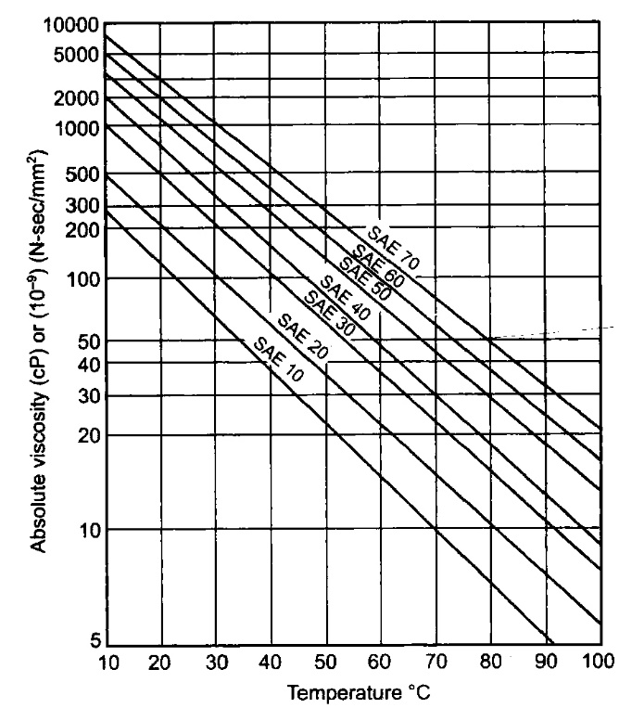
Designers also need to know the viscosity-temperature relationship. This can be gathered from the charts (Fig.2 is an example)
Fig. 2: Viscosity-Temperature relationship for different lubricants

